Slide 1
Transactions
Basic Transaction THEoRY and APPLICATION

Slide 2
Transactions
Chapter 21 of Elmarsi: Introduction to transaction processing concepts and theory
Two points of view:
User of an RDBMS
Developer of an RDBMS
Up to slide 17 is from Elmasri’s slides

Slide 3
Introduction to Transaction Processing (1)
Single-User System:
At most one user at a time can use the system.
Multiuser System:
Many users can access the system concurrently.
Concurrency
Interleaved processing:
Concurrent execution of processes is interleaved in a single CPU
Parallel processing:
Processes are concurrently executed in multiple CPUs.

Slide 4
Introduction to Transaction Processing (2)
A Transaction:
Logical unit of database processing that includes one or more access operations (read -retrieval, write - insert or update, delete).
A transaction (set of operations) may be stand-alone specified in a high level language like SQL submitted interactively, or may be embedded within a program.
Transaction boundaries:
Begin and End transaction.
An application program may contain several transactions separated by the Begin and End transaction boundaries.

Slide 5
Introduction to Transaction Processing (3)
SIMPLE MODEL OF A DATABASE (for purposes of discussing transactions):
A database is a collection of named data items
Granularity of data - a field, a record , or a whole disk block (Concepts are independent of granularity)
Basic operations are read and write
read_item(X): Reads a database item named X into a program variable. To simplify our notation, we assume that the program variable is also named X.
write_item(X): Writes the value of program variable X into the database item named X.

Slide 6
Introduction to Transaction Processing (4)
READ AND WRITE OPERATIONS:
Basic unit of data transfer from the disk to the computer main memory is one block. In general, a data item (what is read or written) will be the field of some record in the database, although it may be a larger unit such as a record or even a whole block.
read_item(X) command includes the following steps:
Find the address of the disk block that contains item X.
Copy that disk block into a buffer in main memory (if that disk block is not already in some main memory buffer).
Copy item X from the buffer to the program variable named X.

Slide 7
Introduction to Transaction Processing (5)
READ AND WRITE OPERATIONS (cont.):
write_item(X) command includes the following steps:
Find the address of the disk block that contains item X.
Copy that disk block into a buffer in main memory (if that disk block is not already in some main memory buffer).
Copy item X from the program variable named X into its correct location in the buffer.
Store the updated block from the buffer back to disk (either immediately or at some later point in time).

Slide 8
Two Sample Transactions

Slide 9
Introduction to Transaction Processing (6)
Why Concurrency Control is needed:
The Lost Update Problem
This occurs when two transactions that access the same database items have their operations interleaved in a way that makes the value of some database item incorrect.
The Temporary Update (or Dirty Read) Problem
This occurs when one transaction updates a database item and then the transaction fails for some reason (see Section 21.1.4).
The updated item is accessed by another transaction before it is changed back to its original value.
The Incorrect Summary Problem
If one transaction is calculating an aggregate summary function on a number of records while other transactions are updating some of these records, the aggregate function may calculate some values before they are updated and others after they are updated.

Slide 10
Concurrent execution is uncontrolled: (a) The lost update problem.

Slide 11
Concurrent execution is uncontrolled: (b) The temporary update problem.

Slide 12
Concurrent execution is uncontrolled: (c) The incorrect summary problem.

Slide 13
Introduction to Transaction Processing (12)
Why recovery is needed:
(What causes a Transaction to fail)
1. A computer failure (system crash):
A hardware or software error occurs in the computer system during transaction execution. If the hardware crashes, the contents of the computer’s internal memory may be lost.
2. A transaction or system error:
Some operation in the transaction may cause it to fail, such as integer overflow or division by zero. Transaction failure may also occur because of erroneous parameter values or because of a logical programming error. In addition, the user may interrupt the transaction during its execution.

Slide 14
Introduction to Transaction Processing (13)
Why recovery is needed (cont.):
(What causes a Transaction to fail)
3. Local errors or exception conditions detected by the transaction:
Certain conditions necessitate cancellation of the transaction. For example, data for the transaction may not be found. A condition, such as insufficient account balance in a banking database, may cause a transaction, such as a fund withdrawal from that account, to be canceled.
A programmed abort in the transaction causes it to fail.
4. Concurrency control enforcement:
The concurrency control method may decide to abort the transaction, to be restarted later, because it violates serializability or because several transactions are in a state of deadlock (see Chapter 22).

Slide 15
Introduction to Transaction Processing (14)
Why recovery is needed (cont.):
(What causes a Transaction to fail)
5. Disk failure:
Some disk blocks may lose their data because of a read or write malfunction or because of a disk read/write head crash. This may happen during a read or a write operation of the transaction.
6. Physical problems and catastrophes:
This refers to an endless list of problems that includes power or air-conditioning failure, fire, theft, sabotage, overwriting disks or tapes by mistake, and mounting of a wrong tape by the operator.

Slide 16
Transaction and System Concepts (1)
A transaction is an atomic unit of work that is either completed in its entirety or not done at all.
For recovery purposes, the system needs to keep track of when the transaction starts, terminates, and commits or aborts.
Transaction states:
Active state
Partially committed state
Committed state
Failed state
Terminated State
Recovery Manager

Slide 17
Desirable Properties of Transactions
ACID properties:
Atomicity: A transaction is an atomic unit of processing; it is either performed in its entirety or not performed at all.
Consistency preservation: A correct execution of the transaction must take the database from one consistent state to another.
Isolation: A transaction should not make its updates visible to other transactions until it is committed; this property, when enforced strictly, solves the temporary update problem and makes cascading rollbacks of transactions unnecessary (see Chapter 21).
Durability or permanency: Once a transaction changes the database and the changes are committed, these changes must never be lost because of subsequent failure.

Slide 18
Simple transaction control in SQL
START TRANSACTION
SAVEPOINT name
ROLLBACK [TO name]
COMMIT
SET AUTOCOMMIT = 0 (off) or 1 (on)

Slide 19
Example
GUI lets you enter items with one-to-many relationships:
A comment with multiple images
A fighter mission with multiple targets, multiple refueling stops, multiple support missions, etc.
User may add/edit/delete sub-items
User may cancel at any time

Slide 20
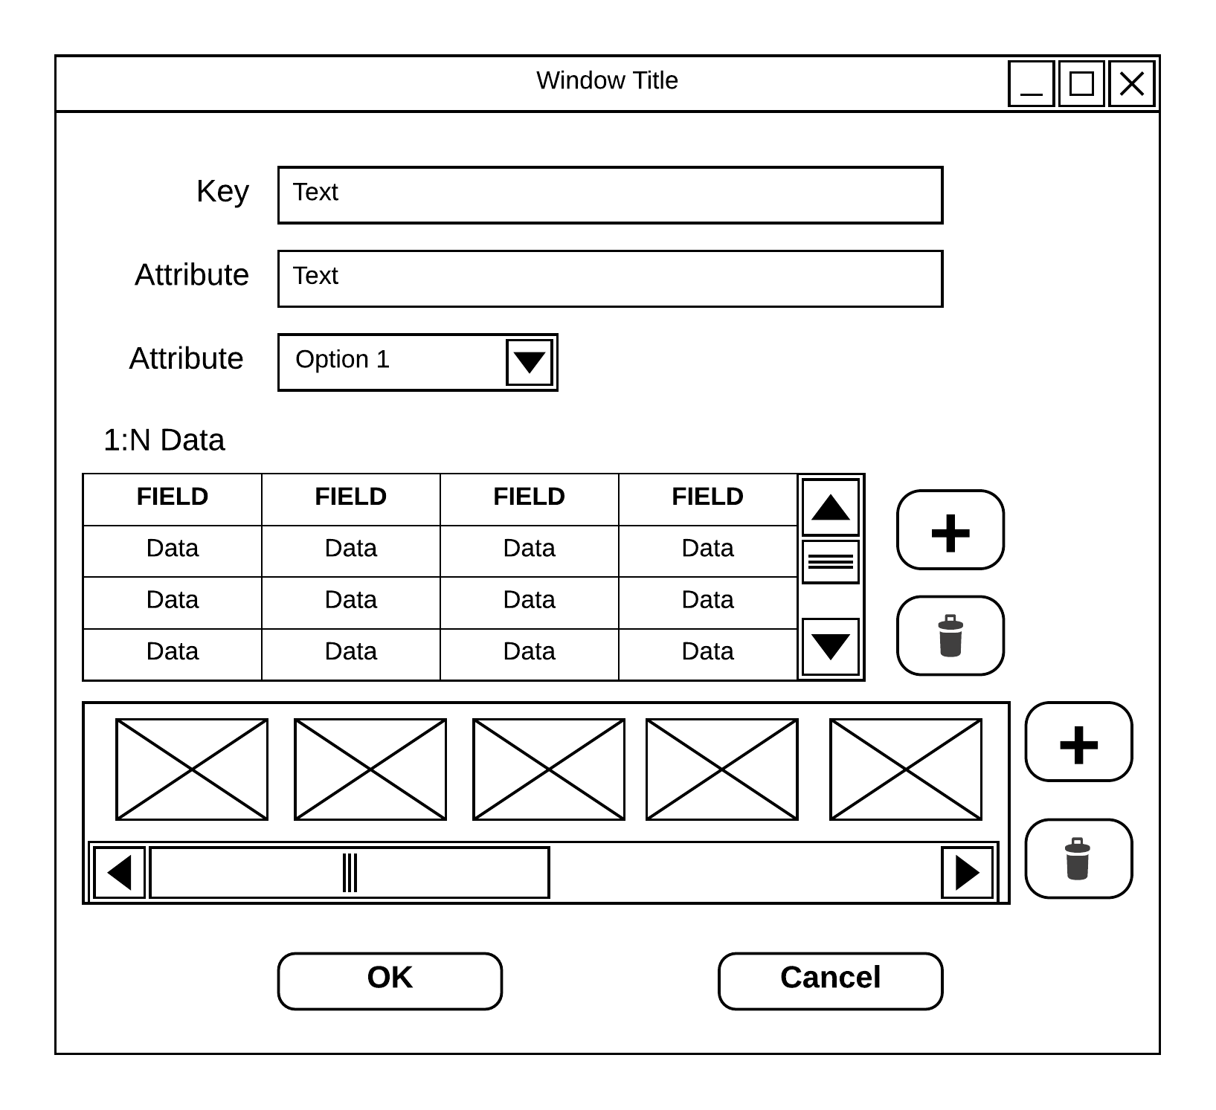
Window opens
START TRANSACTION
INSERT … (empty item, only key)
OK button
UPDATE … (fields)
COMMIT
Saves this item’s fields as well as all the 1-many related items that were added
Cancel button
ROLLBACK
Deletes this item as well as all the 1-many related items that were added

Slide 21
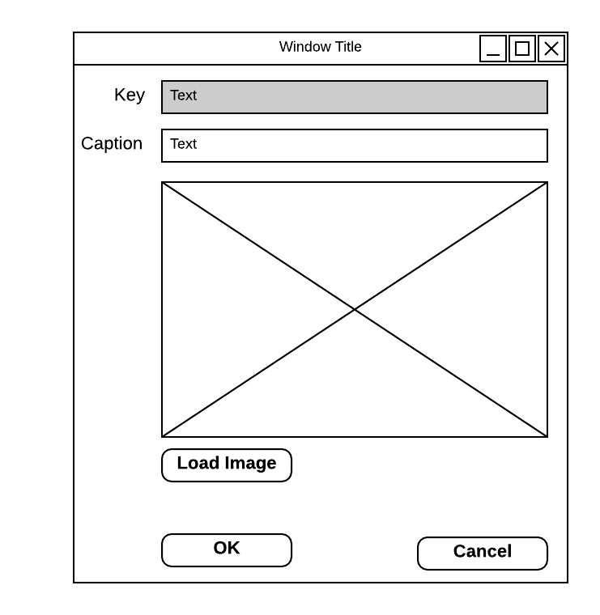
Window opens
SAVEPOINT add-image
INSERT … (empty item, only key, fk)
OK button
UPDATE … (image caption field)
Cancel button
ROLLBACK to add-image

Slide 22
mySQL workbench behavior
Each database connection behaves as a single transaction
bug in some workbench versions causes a connection not to see changes unless restarted
Uncommitted changes may be seen in any query window belonging to same connection
Autocommit is on by default

